Slide 1
Ecommerce Customer Behaviour Analysis
Rohan Deshmukh
DA92S9-EN12024077730

Slide 2
Business Objective:
Alias E-commerce want to see customer behavior churn that can affect there business
So they ask to do analysis is the process of examining customer behavior data to identify patterns and trends that can be used to predict which customers are at risk of churning
Dataset Link

Slide 3
Business Problem statement
Upload data in database for safe keeping and create csv file for tableau creation
See relationship with other column and generate heat map
Using pivot table Analyses churn for product category and gender
Analysis of Churn count
Analysis of Gender on Churn
Customer based on Product category who got churn or not
Analysis on age wise churn rate in customer
Analysis on Every age churn rate in customer
Analysis on Quantity based on Churn
Analysis on Payment Method based on Churn
Analysis on Return based on Quantity with churn as 1
Analysis on Product category based on Returns with churn as 1
Year wise total quantity sold (Tableau)
Churn wise gender and total purchase amount (Tableau)
Gender percentage wise pie chart (Tableau)
Product category wise churn (Tableau)
Year wise, quarter wise and month wise Churn count (Tableau)
Based on Return churn count (Tableau)
Payment method and gender base churn (Tableau)
KPI Dashboard -Ecommerce Customer Behaviour

Slide 4
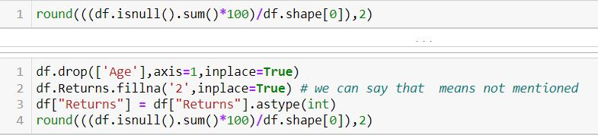
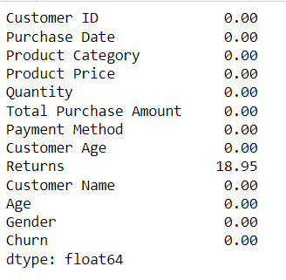
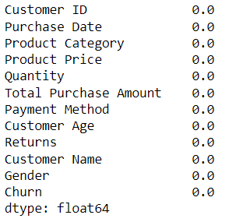
cleaning of data
Check for null values and Duplicate Values if present replace or remove it
Input:
After seeing data we can see that some values are missing in Return column so added 2 as not mention for empty value and age column is repeated so we removed that column
Before
After
Output

Slide 5
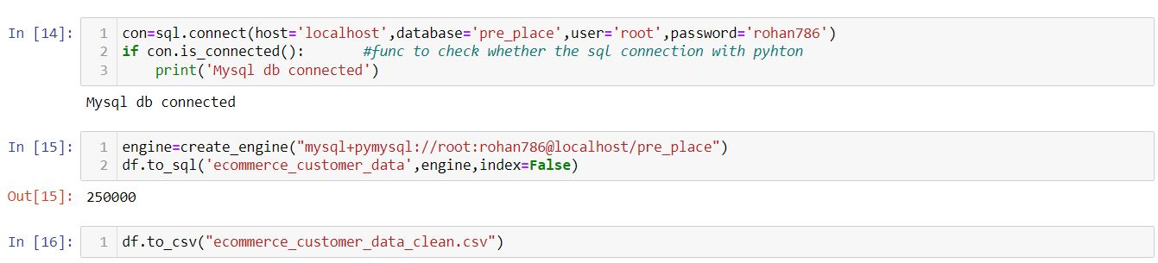
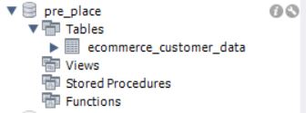
Uploading and Creating Csv file for Tableau
Upload data in database for safe keeping and create csv file for tableau creation
Input:
Output
SQL
Jupyter Notebook

Slide 6
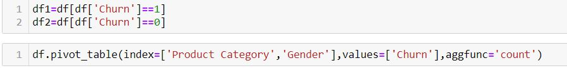
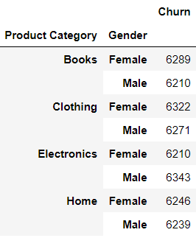
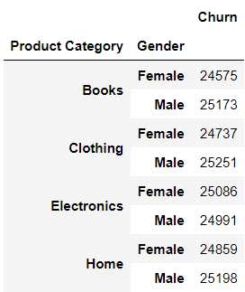
analysis on the data in Python
Using pivot table Analyses churn for product category and gender
Input:
Output
Churn is 1
Churn is 0

Slide 7
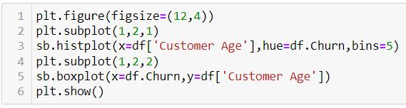
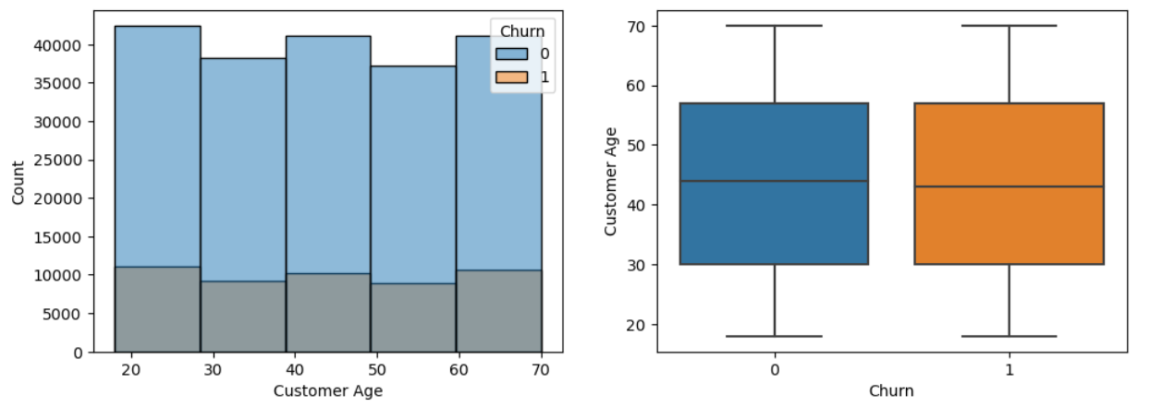
analysis on the data in Python
Analysis on age wise churn rate in customer
Input:
Output

Slide 8

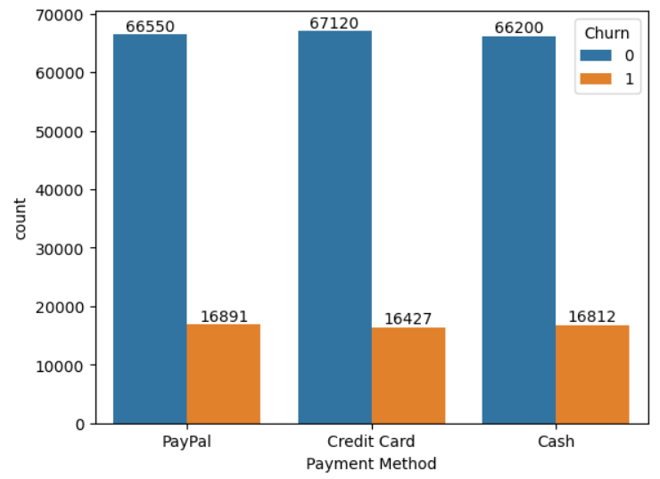
analysis on the data in Python
Analysis on Payment Method based on Churn
Input:
Output

Slide 9
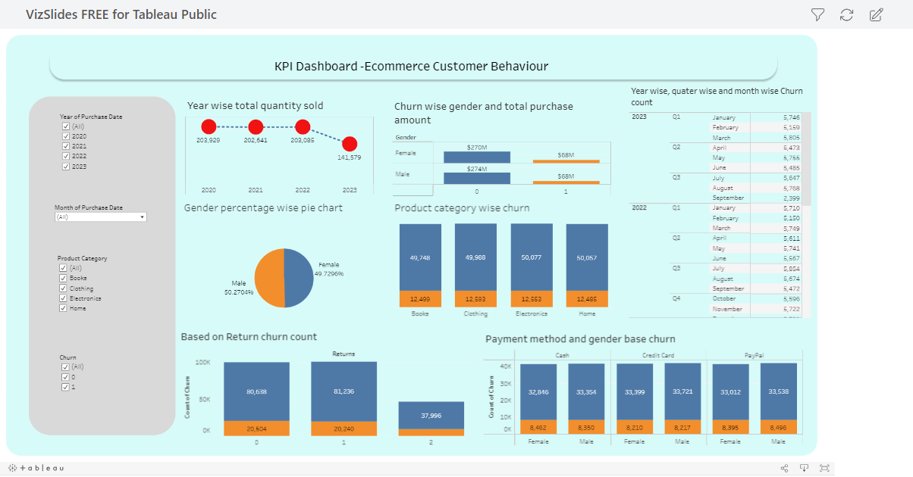
Tableau dashboard
Tableau Dashboard link

Slide 10
conclusion
After doing analysis we can say that amount of Churn customers are very low when we consider the over all data. But there is always going to be 50-50 chance for a customer get churn
Below table show proper conclusion of some of previous analysis
Characteristic | More likely to churn
Gender | Female
Product category | Book, Clothing
Age group | 18-28
Payment method | PayPal

Slide 11
THANK YOU
Rohan Deshmukh
DA92S9-EN12024077730

